Slide 1
Angular CLI
Generating Code from Blueprints
Lecture 4
By James(Jin) Wang
09/28/2019

Slide 2
Outline
Blueprints for most common features
TypeScript blueprints
Options
Aliases
Project configuration

Slide 3
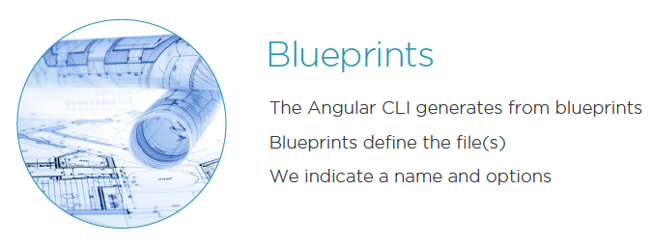
Blueprints for most common features
  The ng generate <blueprint> Command:

Slide 4
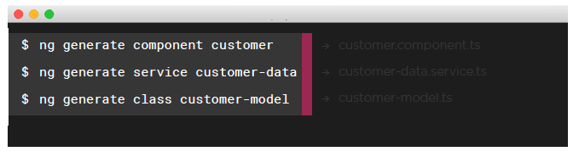
TypeScript blueprints
  Generating from Blueprints:
  The generate command will generate code from a blueprint
  Syntax: ng generate <blueprint> <option>
  Use the --dry-run option to practice

Slide 5
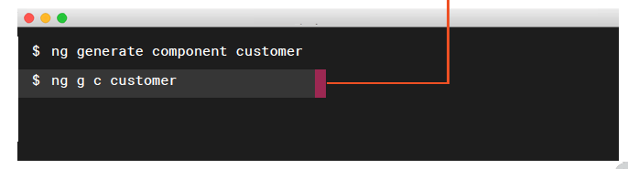
Aliases
  Aliases as Shortcuts:
  The generate command will generate code from a blueprint
  Use the g alias as a shortcut for generate
  Use the c alias as a shortcut for component

Slide 6
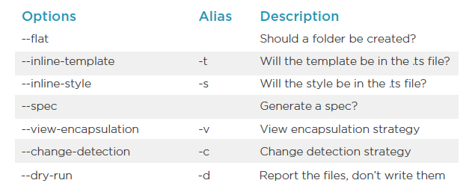
Options

Slide 7
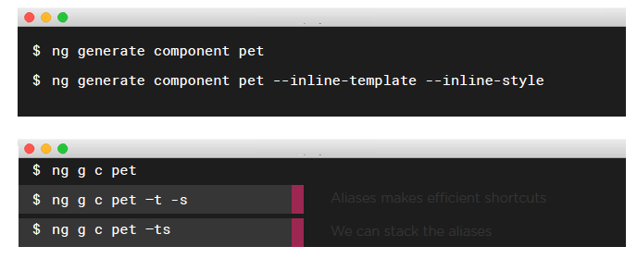
Project Configuration
  Common Ways to Generate Components:

Slide 8
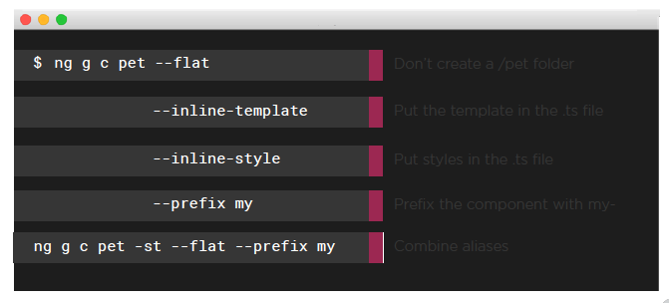
Project Configuration
  Commonly Used Commands:

Slide 9
Demo
  ng new angular-hello
  ng serve -o
  generate Components:
  ng g c customer -d
  ng g c orders --view-encapsulation Emulated
  ng g c orders --v Emulated -c OnPush

Slide 10
Demo
  generate Directives:
  ng g d search-box -d
  ng g d search-box --flat false -d
  generate Services:
  ng g s sales-data -d

Slide 11
Demo
  generate Classes:
  ng g cl models/customer -d
  generate Interfaces:
  ng g i models/person -d
  generate Enums:
  ng g e models/gender -d

Slide 12
Demo
  generate Pipes:
  ng g p shared/init-caps -d
  generate Modules:
  ng g m login -d
  ng g m login --spec false -m app.module -d
  ng g c login -d

Slide 13
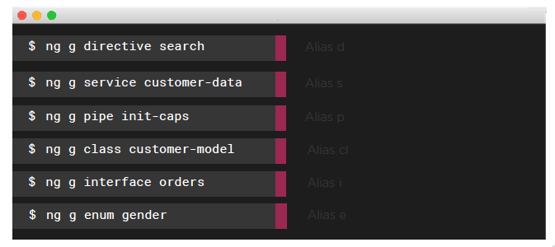
Out-of-the-box Blueprints
  More Blueprints:

Slide 14
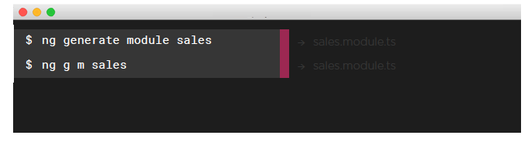
Out-of-the-box Blueprints
  NgModule BluePrints:
  Use ng generate module <options>
  No spec by default
  Consider if we want routing

Slide 15
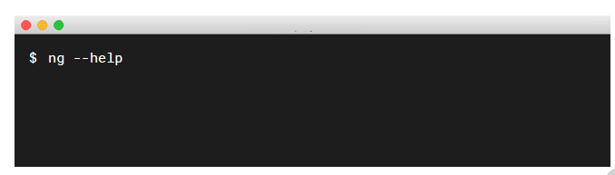
Out-of-the-box Blueprints
  Getting Help:
  Add the --help flag

Slide 16
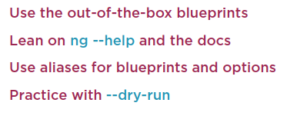
Summary

